Slide 1
C++
Md. Abdur Rahman
Senior Computer Scientist
Centre for Advanced in Research in Sciences (CARS)
University of Dhaka

Slide 2
Constructors
A constructor is a member function of a class which initializes objects of a class. In C++,Constructor is automatically called when object(instance of class) create. It is special member function of the class.
class MyClass{
int a;
public:
MyClass() //constructor
{
cout << "In Constructor\n";
a = 10;
}
};

Slide 3
Types of Constructors
Default Constructors: Default constructor is the constructor which doesn’t take any argument. It has no parameters.
class MyClass{
int a;
public:
MyClass() //constructor with no parameter
{
cout << "In Constructor\n";
a = 10;
}
};

Slide 4
Types of Constructors
Parameterized Constructors
It is possible to pass arguments to constructors. Typically, these arguments help initialize an object when it is created.
class Point
{
private:
int x, y;
public:
Point(int x1, int y1) // Parameterized Constructor
{
x = x1;
y = y1;
}
};

Slide 5
Uses of Parameterized constructor
It is used to initialize the various data elements of different objects with different values when they are created.
It is used to overload constructors.

Slide 6
Constructor
Can we have more than one constructors in a class?
Yes, It is called Constructor Overloading.
Copy Constructor
A copy constructor is a member function which initializes an object using another object of the same class.

Slide 7
Destructor
Destructor is a member function which destructs or deletes an object.
When is destructor called?
A destructor function is called automatically when the object goes out of scope:
the function ends
the program ends
a block containing local variables ends
a delete operator is called
~MyClass(); // destructor

Slide 8
Inheritance
In OOP, we could organize classes in hierarchy to avoid redundancy. We can extend a subclass (or derived class) from a superclass (or base class). The subclass inherits the members of the superclass, known as inheritance.
class SubclassName : inheritance-access-specifier SuperclassName { ...... };

Slide 9
Modes of Inheritance
Public mode
If we derive a sub class from a public base class. Then the public member of the base class will become public in the derived class and protected members of the base class will become protected in derived class. Private members of the base class will never get inherited in sub class.

Slide 10
Modes of Inheritance
Protected mode
If we derive a sub class from a Protected base class. Then both public member and protected members of the base class will become protected in derived class. Private members of the base class will never get inherited in sub class.
Private mode
If we derive a sub class from a Private base class. Then both public member and protected members of the base class will become Private in derived class. Private members of the base class will never get inherited in sub class.

Slide 11
Modes of Inheritance
 | Derived Class | Derived Class | Derived Class
Base Class | Public Mode | Private Mode | Protected Mode
Private | Not Inherited | Not Inherited | Not Inherited
Protected | Protected | Private | Protected
Public | Public | Private | Protected
Access Control
Access | public | protected | private
Same class | yes | yes | yes
Derived classes | yes | yes | no
Outside classes | yes | no | no

Slide 12
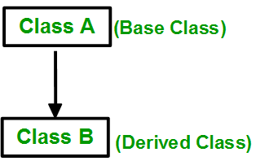
Types of Inheritance in C++
Single Inheritance
In single inheritance, a class is allowed to inherit from only one class. i.e. one sub class is inherited by one base class only.

Slide 13

Types of Inheritance
Multiple Inheritance
Multiple Inheritance is a feature of C++ where a class can inherit from more than one classes. i.e one sub class is inherited from more than one base classes.

Slide 14
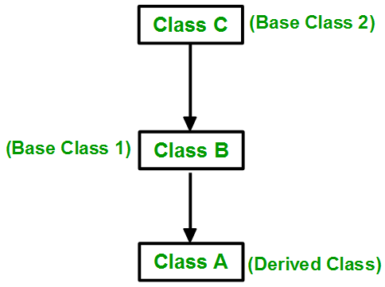
Types of Inheritance
Multilevel Inheritance
In this type of inheritance, a derived class is created from another derived class.

Slide 15
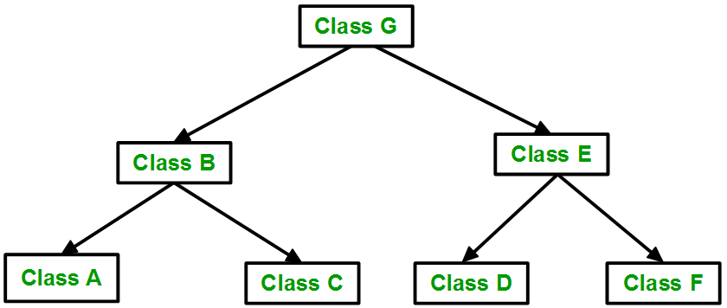
Hierarchical Inheritance
In this type of inheritance, more than one sub class is inherited from a single base class. i.e. more than one derived class is created from a single base class.

Slide 16
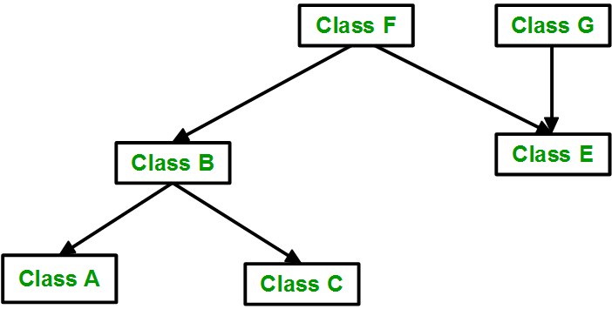
Hybrid (Virtual) Inheritance
Hybrid Inheritance is implemented by combining more than one type of inheritance.

